Slide 1
From Anger to Intimacy: Reignite Your Marriage with Forgiveness, Understanding, and Appreciation
Ted Cunningham
https://woodhills.org/aacc-downloads/

Slide 2
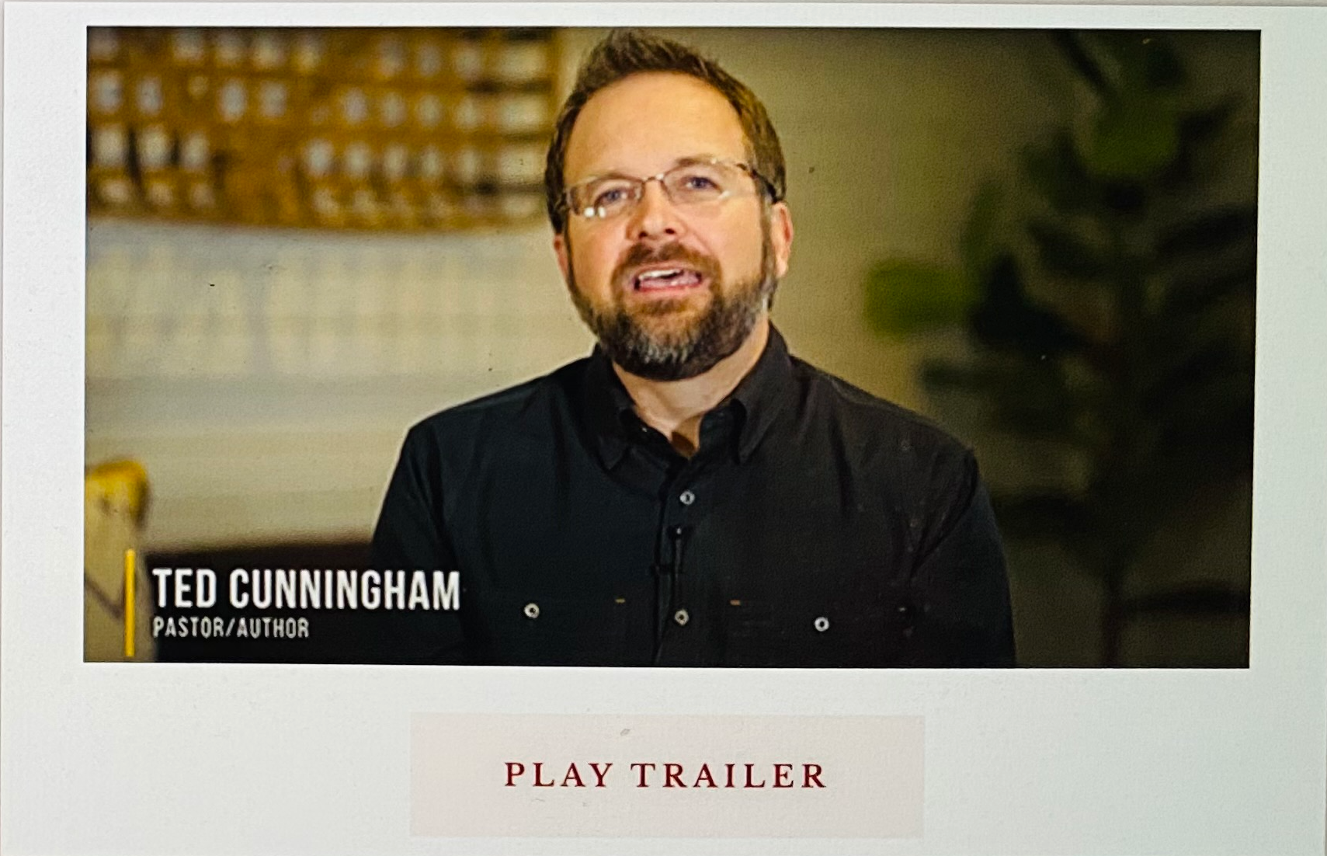
www.helpingcoupleswin.com

Slide 3
Mom: “What does IDK, LY, and TTYL mean?”

Slide 4
Mom: “What does IDK, LY, and TTYL mean?”
Son: “I don’t know, love you, talk to you later.”

Slide 5
Mom: “What does IDK, LY, and TTYL mean?”
Son: “I don’t know, love you, talk to you later.”
Mom: “Okay, I’ll ask your sister.”

Slide 6
“I’m sorry you feel that way.”

Slide 7
“I’m sorry you feel that way.”
“You shouldn't feel that way.”

Slide 8
“If I offended you, I’m sorry.”

Slide 9
“If I offended you, I’m sorry.”
“You’re too sensitive.”

Slide 10
“I’m sorry you took
it that way.”

Slide 11
“I’m sorry you took
it that way.”
“You read more into that
than I intended.”

Slide 12
“I’m sorry I said it that way.”

Slide 13
“I’m sorry I said it that way.”
“What I told you was truth
and you needed to hear it,
but maybe I could have
said it better.”

Slide 14
3 of the hardest things to say…
“I’m sorry”
“I was wrong”
“Worcestershire Sauce"

Slide 15
3 of the hardest things to say…
“I’m sorry”
“I was wrong”
“Worcestershire Sauce"

Slide 16
3 of the hardest things to say…
“I’m sorry”
“I was wrong”
“Worcestershire Sauce"

Slide 17
3 of the hardest things to say…
“I’m sorry”
“I was wrong”
“Worcestershire Sauce"

Slide 18
Marital satisfaction depends on factors and skills couples can do something about in any season or stage of life.

Slide 19
When filled with anger, you…
blame your spouse
question your compatibility
close your heart
isolate from others
doubt your future
explore other options

Slide 20
When filled with anger, you…
blame your spouse
question your compatibility
close your heart
isolate from others
doubt your future
explore other options

Slide 21
When filled with anger, you…
blame your spouse
question your compatibility
close your heart
isolate from others
doubt your future
explore other options

Slide 22
Unresolved anger is like
drinking poison expecting the other person to get sick.

Slide 23
You never bury anger dead,
you always bury it alive.

Slide 24
Unreconciled relationships do not get better over time.

Slide 25
Be kind and compassionate to one another, forgiving each other, just as in Christ God forgave you.
Ephesians 4:32

Slide 26
I forgive because
I’m forgiven.

Slide 27
My inability to forgive
is a Source problem,
not a spouse problem.

Slide 28
I forgive you because
I want you to forgive me.

Slide 29
“keeps no record of wrongs.”
1 Corinthians 13:5

Slide 30
In sports, we keep score so we can have a winner and a loser.
In relationships, we do not keep score because we are on the same team.

Slide 31
I won’t keep a record of your wrongs because I don’t want you to keep a record of mine.

Slide 32
When filled with anger, you…
blame your spouse
question your compatibility
close your heart
isolate from others
doubt your future
explore other options

Slide 33
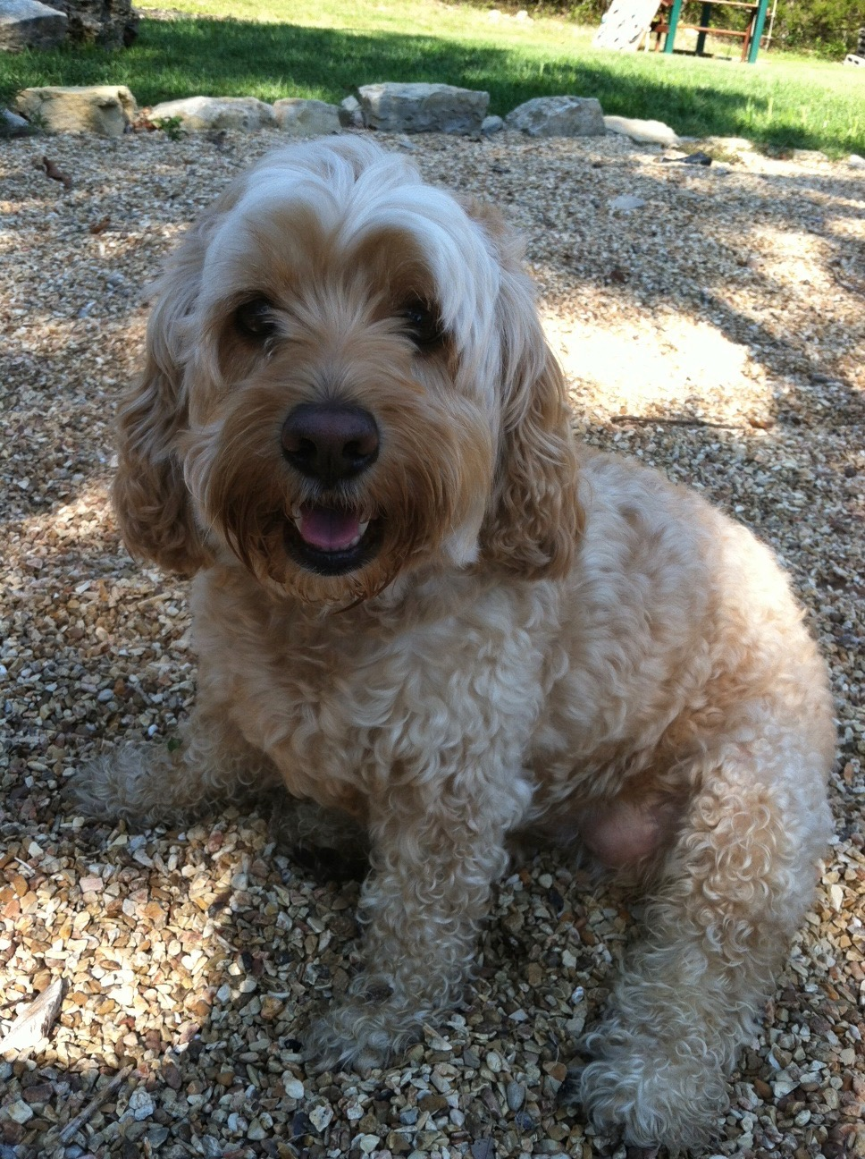

Slide 34
Every marriage is a duet in need of great backup singers.

Slide 35
We rejoice and delight in you,
we will praise your love more than wine.
Song of Solomon 1:4

Slide 36
When filled with anger, you…
blame your spouse
question your compatibility
close your heart
isolate from others
doubt your future
explore other options

Slide 37
When filled with anger, you…
blame your spouse
question your compatibility
close your heart
isolate from others
doubt your future
explore other options

Slide 38
The Six Levels
of Communication

Slide 39
Above all else, guard your heart,
for it is the wellspring of life.
Proverbs 4:23

Slide 40
Your heart is a “tablet”
Proverbs 3:3

Slide 41
The purposes of a person’s heart are deep waters,
but one who has insight draws them out.
Proverbs 20:5

Slide 42
Level 1 - Small Talk
Level 2 -
Level 3 -
Level 4 -
Level 5 -
Level 6 -

Slide 43
Level 1 - Small Talk
Level 2 - Facts
Level 3 -
Level 4 -
Level 5 -
Level 6 -

Slide 44
Level 1 - Small Talk
Level 2 - Facts
Level 3 - Opinions
Level 4 -
Level 5 -
Level 6 -

Slide 45
Level 1 - Small Talk
Level 2 - Facts
Level 3 - Opinions
Level 4 - Feelings
Level 5 -
Level 6 -

Slide 46
Level 1 - Small Talk
Level 2 - Facts
Level 3 - Opinions
Level 4 - Feelings
Level 5 - Desires / Needs
Level 6 -

Slide 47
Level 1 - Small Talk
Level 2 - Facts
Level 3 - Opinions
Level 4 - Feelings
Level 5 - Desires / Needs
Level 6 - Beliefs

Slide 48
www.helpingcoupleswin.com

